Slide 1


G H PATEL COLLEGE OF ENGINEERING & TECHNOLOGY
(THE CHARUTAR VIDYA MANDAL (CVM) UNIVERSITY)
Department of Information Technology
Multi-Modal RAG Agent for Enterprise Guidelines
Industrial Internship (202000801)
Second Presentation
27th February, 2026
Presented By
External Guide
Internal Guide
Krupa Dhaval Jantrania
12202130501036
CSD, GCET
Kajal Mishra
Software eng – data scientist
Aziro Technologies Pvt. Ltd.
Pune
Dr. kinjal joshi
CP Department, GCET,
Vallabh Vidyanagar

Slide 2
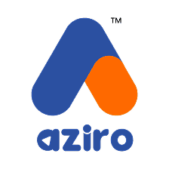
Company Profile
Company Name: Aziro Technologies Pvt. Ltd.
Location: Pune, Maharashtra
Aziro Technologies is a technology-driven software company focused on:
AI & Data Science solutions
Enterprise software development
Research-oriented problem solving
Strong emphasis on:
Modern AI stacks
Scalable architectures
Real-world problem solving
Internship environment encouraged:
Independent exploration
Hands-on learning
Research-based implementation
12202130501036

Slide 3
What is RAG?
Retrieval-Augmented Generation (RAG) : Retrieval-Augmented Generation (RAG) is an AI framework that improves LLM accuracy by fetching relevant, up-to-date information from external, trusted knowledge bases, such as internal company documents or databases, before generating a response.
Traditional LLM:
Static knowledge
Cannot access enterprise documents
Risk of hallucination
RAG:
Retrieves relevant document chunks
Injects context into LLM
Generates grounded answers
- It is more accurate, reduces hallucination and, is more enterprise-ready.
12202130501036

Slide 4
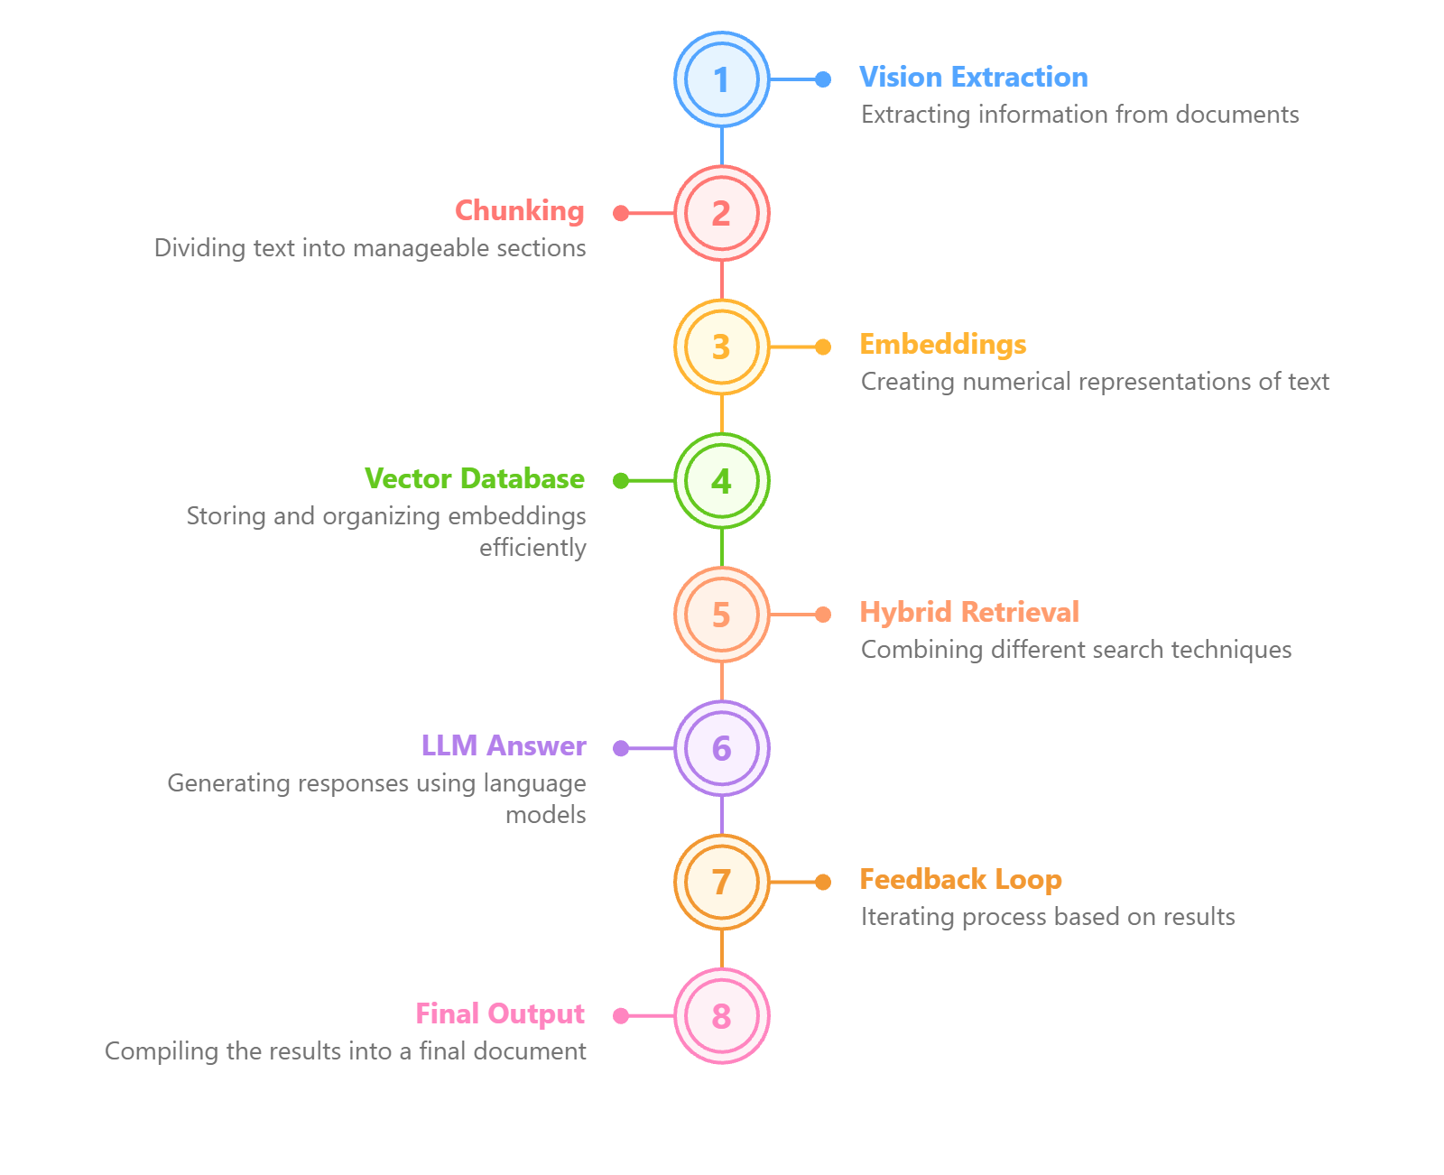
System Overview
12202130501036

Slide 5
Vision-based PDF Extraction
Vision-Based Ingestion:
Instead of basic PDF parsing:
Each page converted to image (PyMuPDF)
Sent to Groq Vision model
Reconstructed as structured Markdown
Advantages:
Handles complex tables
Extracts text from screenshots
Preserves layout
Works for scanned PDFs
12202130501036

Slide 6
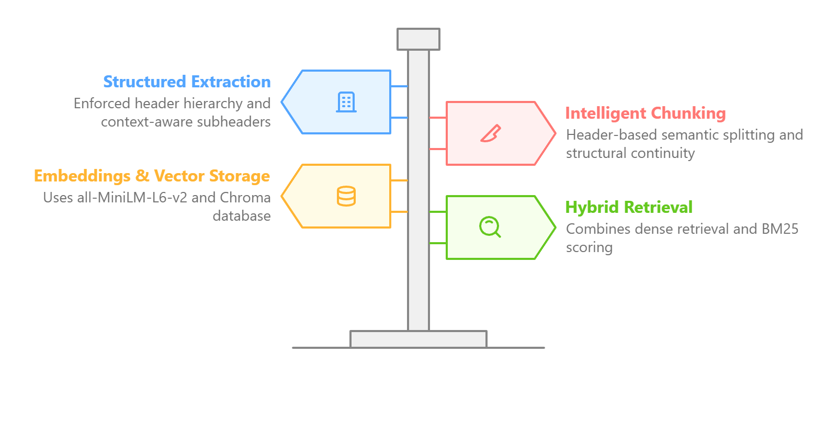
Core RAG Pipeline Architecture
12202130501036

Slide 7
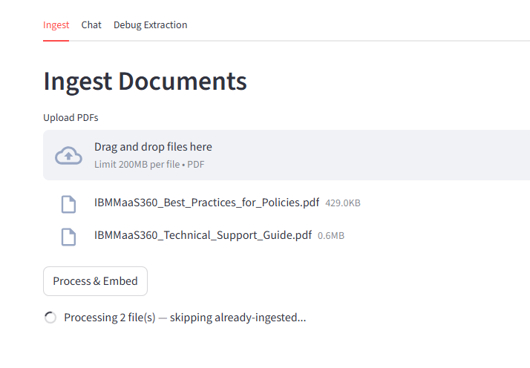
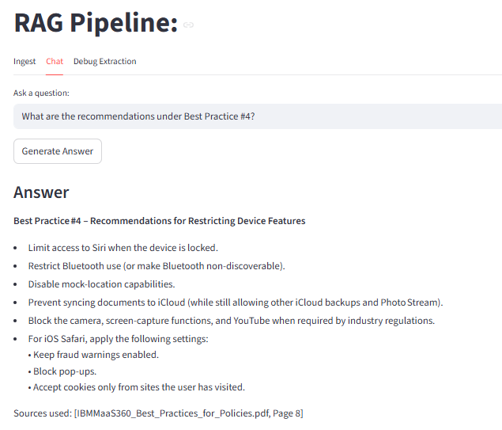
Screenshots
12202130501036

Slide 8
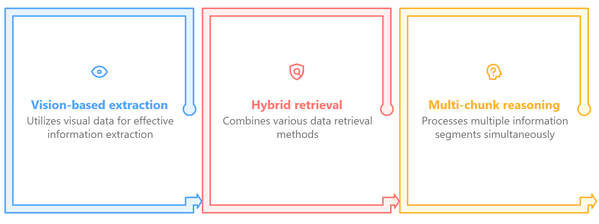
Conclusion
12202130501036

Slide 9
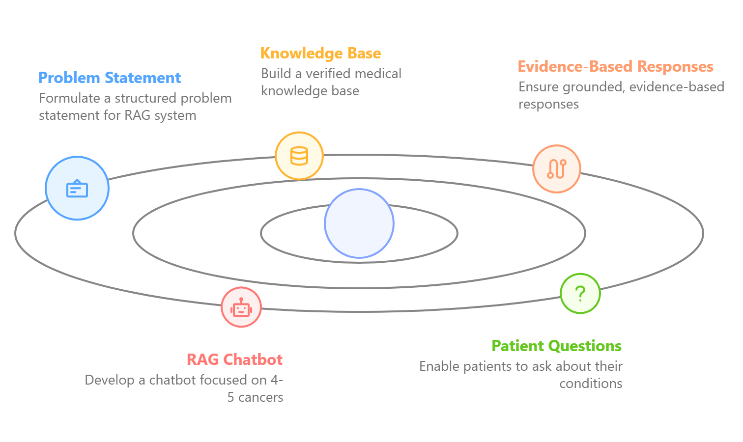
Future Scope
12202130501036

Slide 10
References
Aziro Technologies – Official Website - https://www.aziro.com/en
LangChain Documentation - https://docs.langchain.com/
Docling Documentation - https://docling-project.github.io/docling/
12202130501036

Slide 11
Thank You…
12202130501036

